Slide 1
Mario game
Salena youhana

Slide 2
introduction
My project is a Mario game that is like Alien Invasion.
There is fireballs coming from the Dragon and Mario must dodge them or it’s game over.

Slide 3
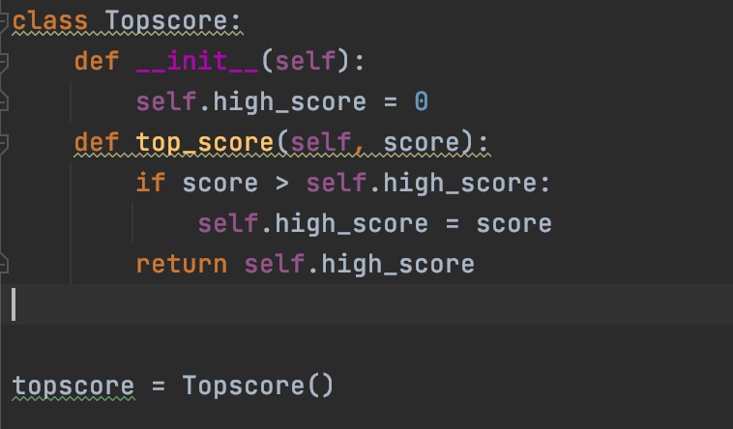
Class topscore

Slide 4
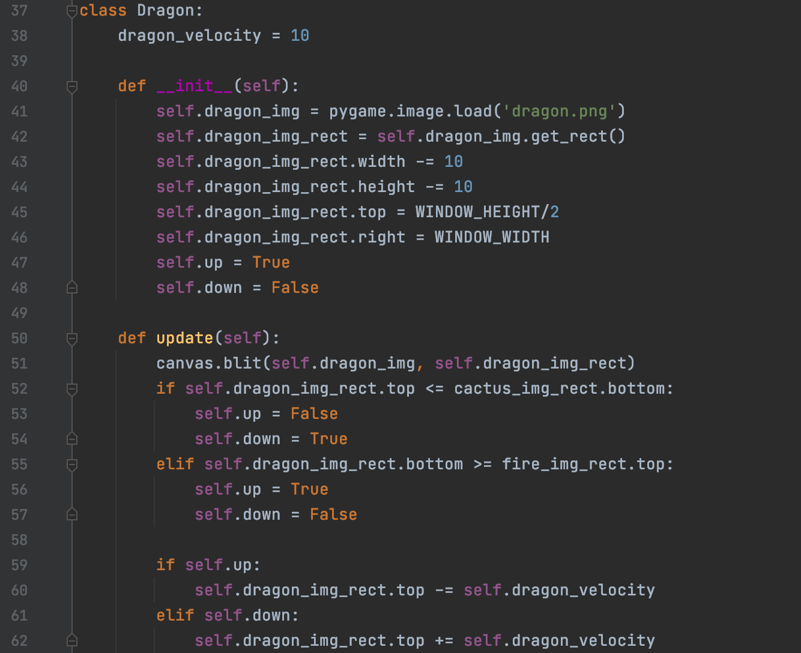
Class dragon

Slide 5
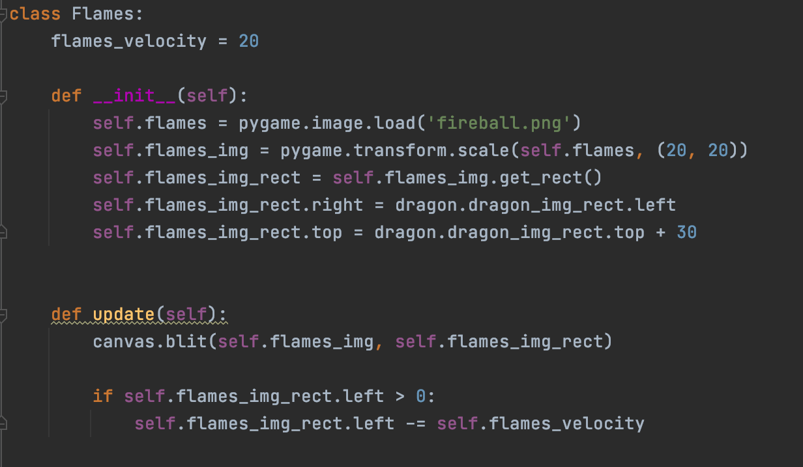
Class flames

Slide 6
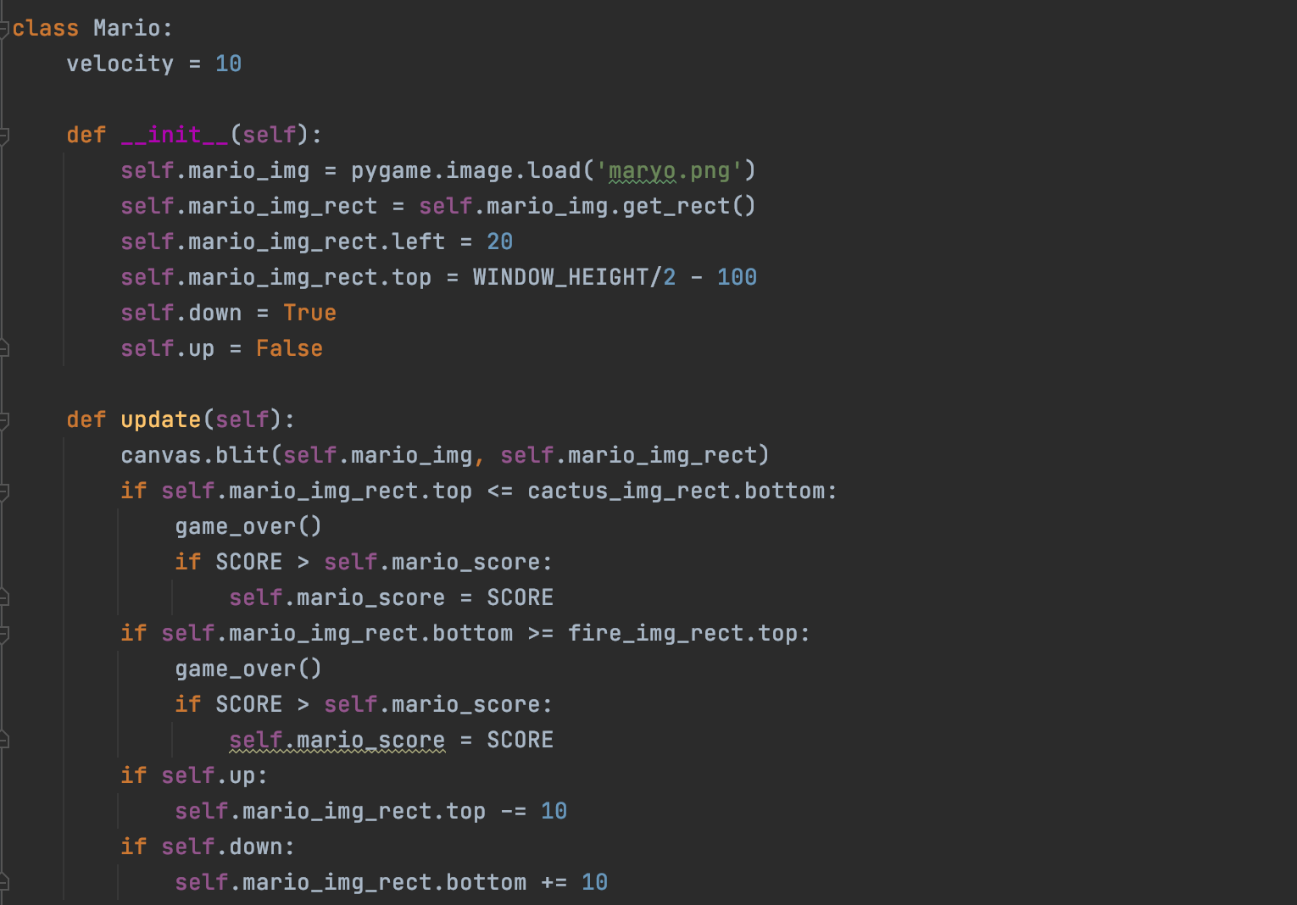
Class mario

Slide 7
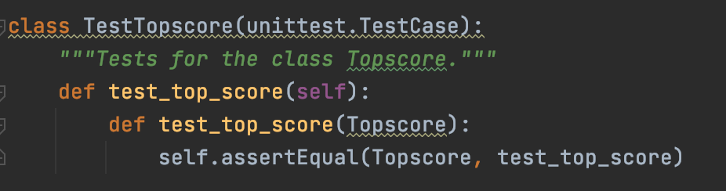
Test case - topscore

Slide 8
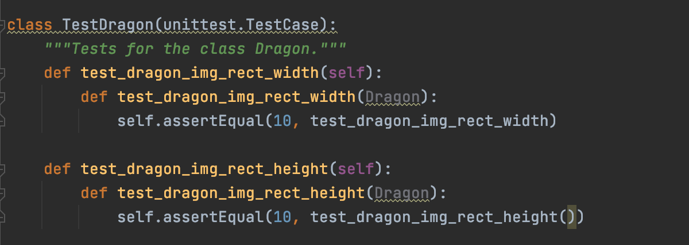
Test case - dragon

Slide 9
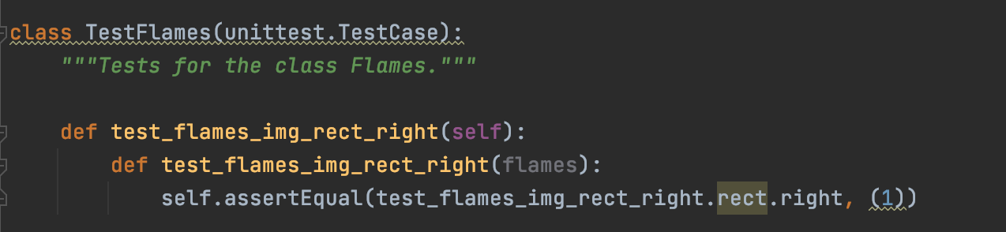
Test case - flames

Slide 10
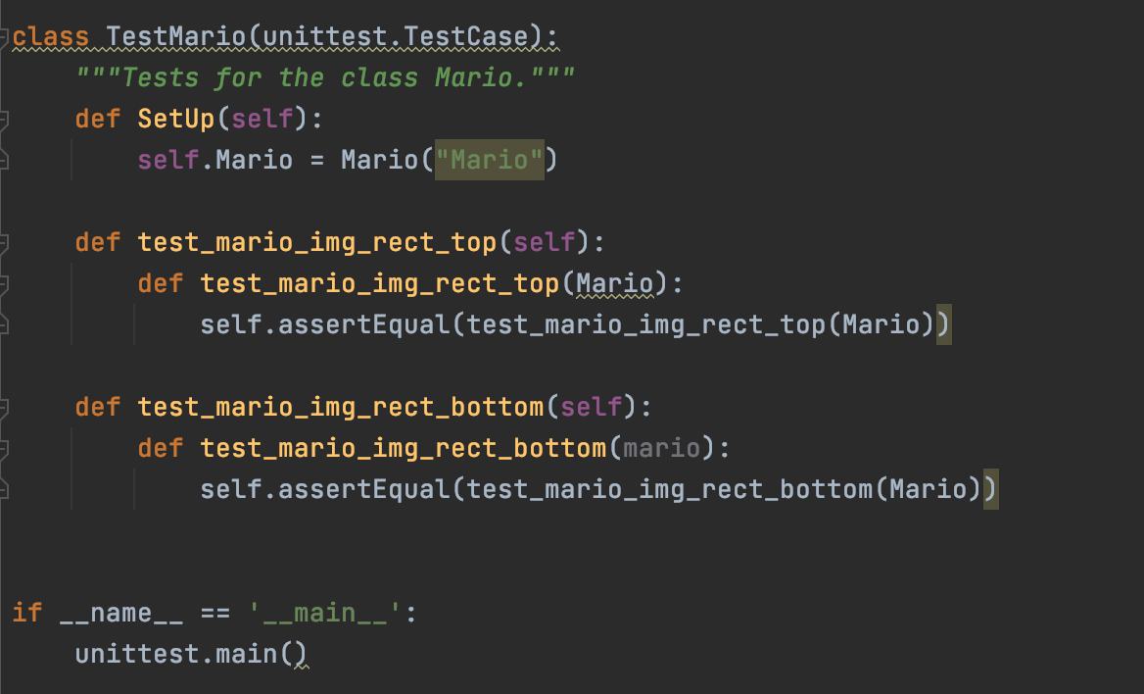
Test case - mario

Slide 11
Lessons learned
I learned how to put different skills together and that you might have keep trying different ideas until one works.
I also learned how to use Pygame since I have never used it before.

Slide 12
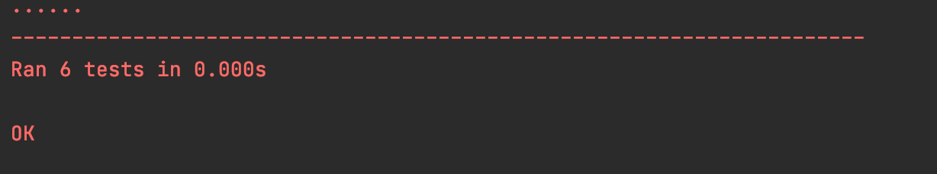

troubleshooting
I had a hard time with the Test Cases and how to put them in a different file. But I was eventually able to figure them out.
I also had trouble with libpng warning and could not figure out how to fix it.

Slide 13
Github
https://github.com/salenayouhana/FinalProject

